Slide 1
Ensemble Learning
UIUC EC0N 490: Applied Machine Learning in Economics

Slide 2
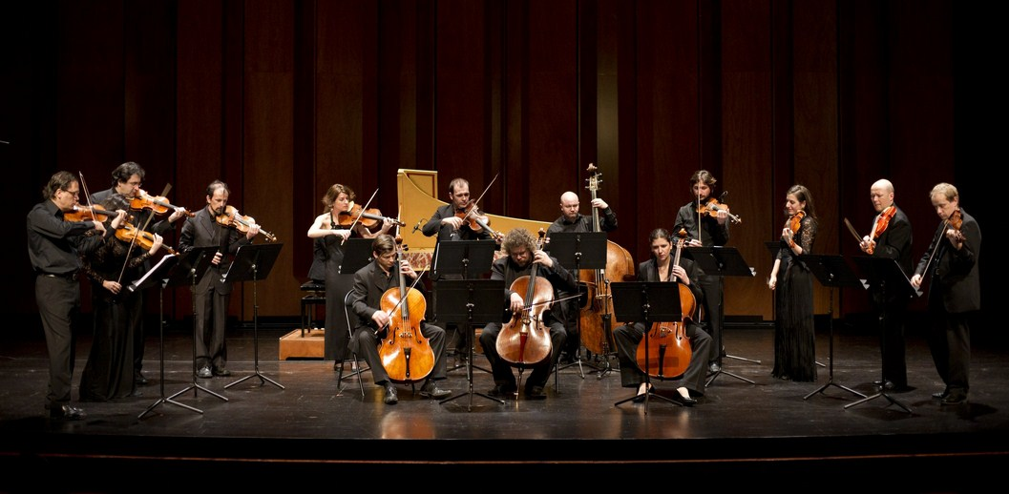
Ensemble

Slide 3
Ensemble Learning
Multiple models working together
Examples
Bagging
Boosting
Stacking

Slide 4
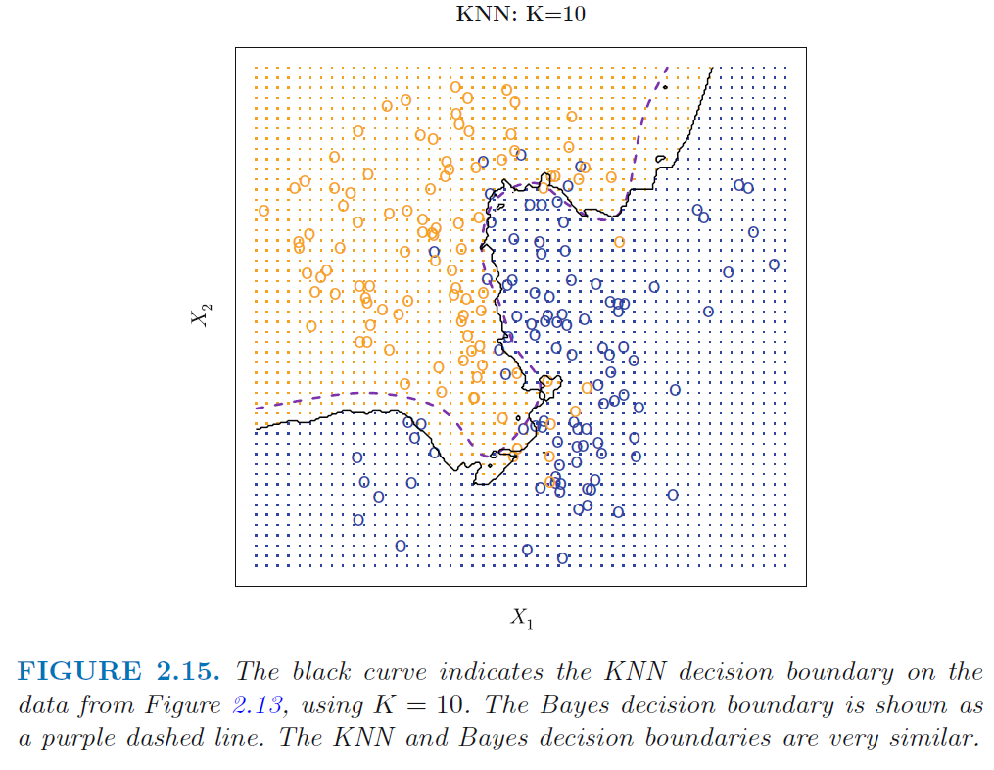
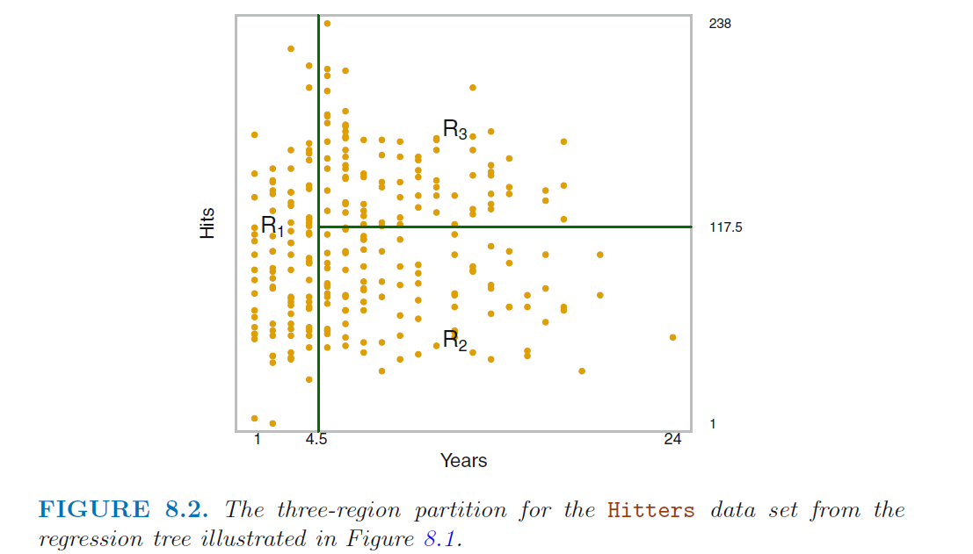
Stacking
Fit multiple classes of models (base learners) with different decision boundaries
KNN Random Forest

Slide 5

Stacking – Regression
Fit $n$ base learners
OLS
KNN
RF
Produce ensemble
Averaging
Weighted average (CV)
Model-based aggregation
Fit a model on predicted values from base learners
Ex) OLS

Slide 6
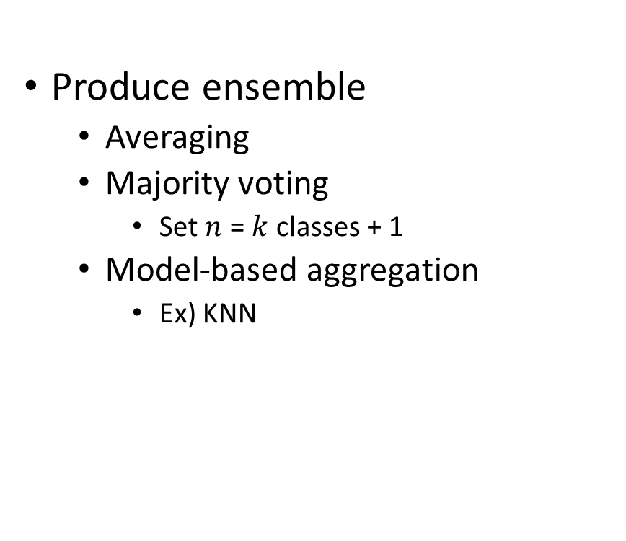
Stacking – Classification
Fit $n$ base learners
OLS
KNN
RF
Produce ensemble
Averaging
Majority voting
Set $n$ = $k$ classes + 1
Model-based aggregation
Ex) KNN

Slide 7
To Do
Read
Support vector machines
Ch 9.1, 9.2, 9.3
Complete
Replicate the lecture code in an .R script

